Slide 1
Presentation on Smart Dustbin
Project by
Mr. Ashish Kore (2016BTEIT00065)
Mr. Mohit Gholake (2016BTEIT00066)
Mr. Aditya Kole (2016BTEIT00070)
Group No. 3
Under the Guidance of
Prof. B. S. Shetty
1
Notes:
1

Slide 2
AGENDA
Problem Identification
Gaps in Existing Systems
Objectives
Methodology
Architecture Model
Technologies
1
Notes:
1

Slide 3
Problem Identification
Waste management is one of the primary problems that the world faces irrespective of develop or developing countries.
The key issue in waste management is the dustbin at public places gets overflowed well in advance before the commencement of the next cleaning process
It leads to various hazards such as bad odour and ugliness to that place which may be the root cause for the spread of various disease.
1

Slide 4
Gaps in Existing Systems
Todays garbage collection system works in traditional way in which garbage collector suppose to visit each and every dustbin to collect garbage.
Traditional garbage collection system has its so many cons as follows:
One by one checking of dustbins does not ensure the presence of sufficient amount of garbage in dustbin.
Some time garbage containers get overfilled and all garbage get spread on the road which creates unhygienic condition.
Sometimes people throws garbage outside the dustbin without properly opening containers.
1

Slide 5
Objectives
Project is to design and build a prototype for an automatic open dustbin that can automatically open the lid when it detects the people who want to throw out their trash.
It detect the level of the trash that inside the dustbin Also can detect level of dust present in room
In case of dustbin level or dust level is full send an alert text message to concerned authorities for cleaning purposes.
1

Slide 6
Methodology
This project is to design and build a prototype for a smart dustbin using Arduino.
It will have automatic lid opening mechanism by detecting person using ultrasonic sensor.
Using ultrasonic sensor it will detect level of garbage in dustbin and send data to ThingSpeak cloud.
We will fetch data from ThingSpeak cloud in android application and show level of garbage.
When garbage level is greater than threshold then it will send notification to concerned person.
Also when Dust present in room cross the particular threshold it will send notification to the concern person
1

Slide 7
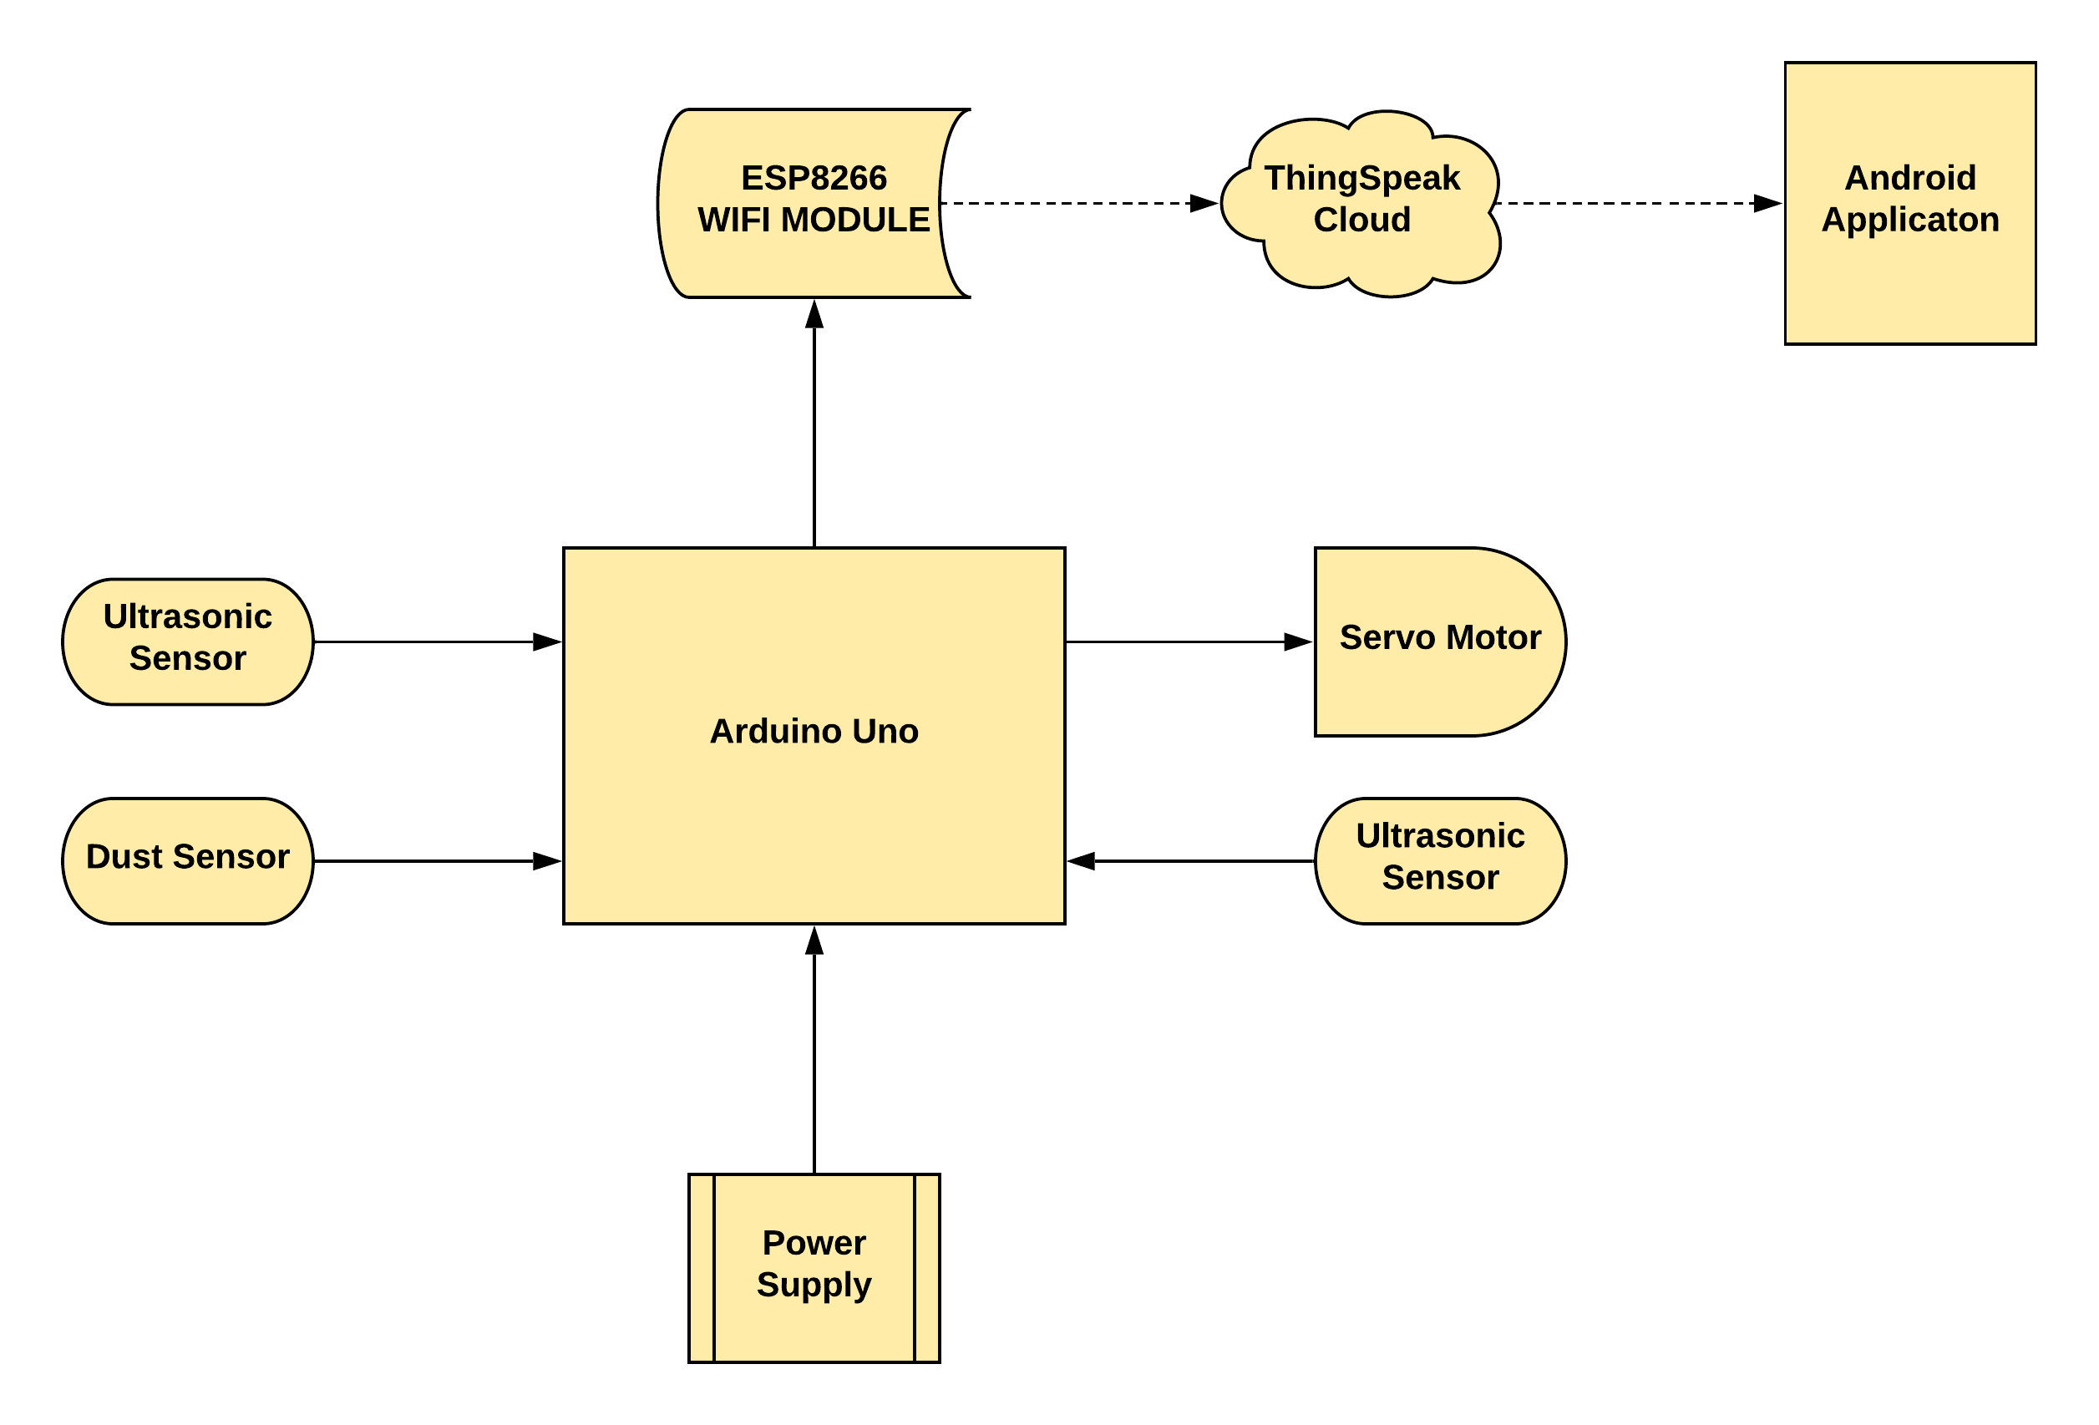
Architecture Model
1

Slide 8
Technologies
Software:
Arduino IDE
C Programming
ThingSpeak Cloud
Android Application
Hardware:
Arduino UNO
Ultrasonic Sensor
Dust Sensor
ESP8266 Wifi Module
Servo Motor
Power Supply
Bread Board
Jumper Wires
1

Slide 9
THANK YOU !!!
1

